Slide 1






Mandeavor Software Solutions Inc: Sales Strategy Initiative
Scenario
Sales have been declining in certain regions where we do business. We will embark on a strategic initiative to shore up sales in those regions to ensure management goals are met.
Purpose
To unlock sales insights that are not visible for sales team to enable decision making and automate it to reduce manual time spent in data gathering.
Stake holders
Director of sales
Marketing Department
Customer Service Department
Data & Analytics Department
IT
Sales Strategy
Goal
An automated dashboard providing a quick and up-to-date view of sales insights in order to support data driven decision making
Dashboard which extracts sales order insights using most relevant data
Enable Sales Team to make better decisions while realizing a 10% cost savings of total spend
Enable Sales Analysts to avoid gathering data manually to regain 20% of their time and redirect it towards value added activity
Success Criteria

Slide 2
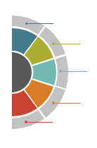
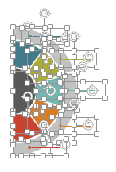
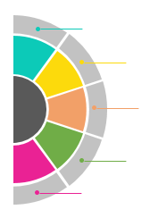
All images are 100% editable in PowerPoint
“Change color, size and orientation of any icon to your liking”

Slide 3
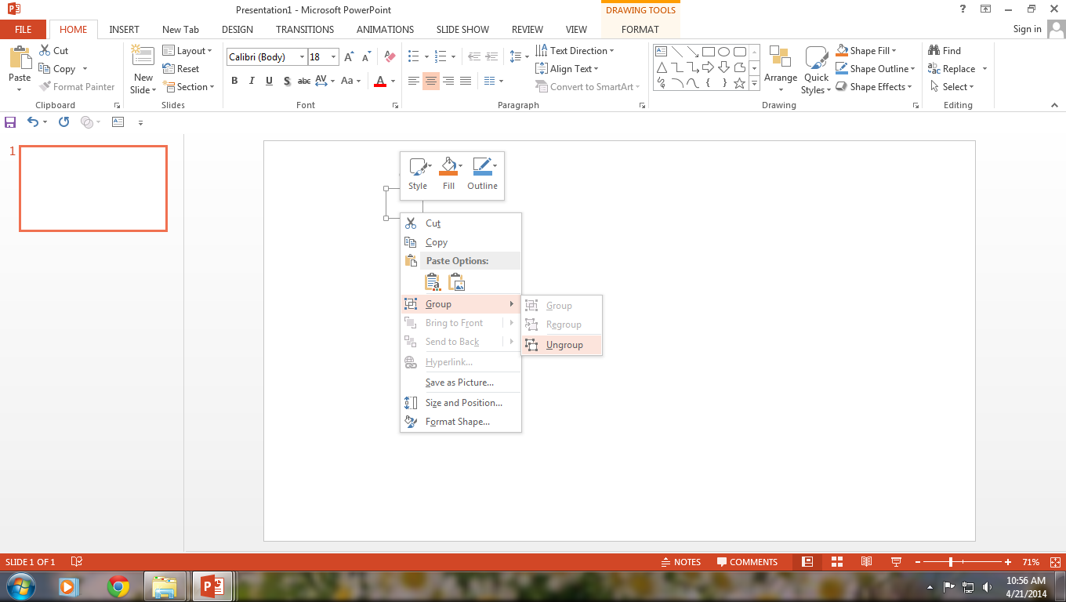

Ungrouping the object
2
1
3
Right click the object.
Choose Group and then Ungroup.
Click beside the object and drag the arrow over it.

Slide 4
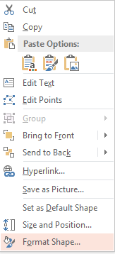
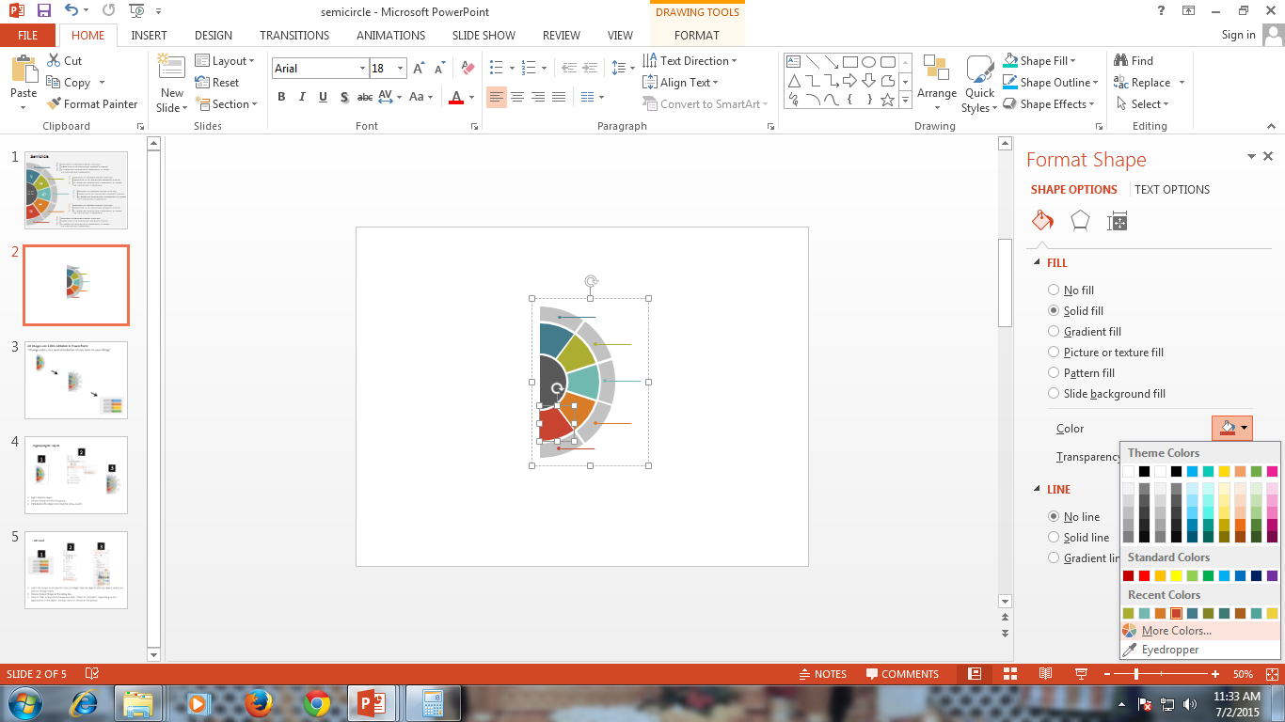
Edit Color
2
3
1
Select the shape to change the color and Right click the object( click any object which you want to change color)
Choose Format Shape in the dialog box.
Choose “Fill” in the Format Shape box then “Solid” or “Gradient” depending on the appearance of the object. Change colour as shown in the picture.

